Slide 1

Taxi Fare Calculator: Streamlining Your Rides
Navigating the complexities of taxi fares can be a hassle, but our Taxi Fare Calculator makes it easy to estimate the cost of your ride before you even step into the cab. Whether you're a daily commuter or an occasional traveler, this tool puts you in control of your transportation costs.

Slide 2
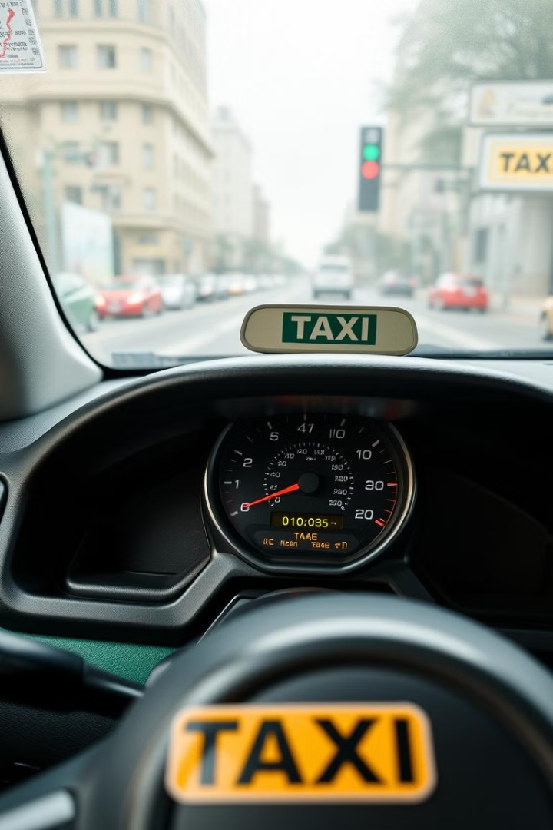
Overview of Taxi Fare Calculation
1
Distance-Based Pricing
2
Dynamic Rates
Fares can vary depending on the time of day, day of the week, and even traffic conditions, requiring real-time calculation.
Taxi fares are primarily calculated based on the distance traveled, with additional charges for factors like time and location.
3
Transparency and Fairness
Providing a transparent and fair fare system is crucial for building trust with passengers.

Slide 3
Factors Influencing Taxi Fares
Distance
Time
Location
The primary factor, with a base fare plus a per-mile rate.
Fares may increase during peak hours or for longer waiting times.
Fares can be higher in certain zones or for airport pickups.

Slide 4

Integrating Java and SQL for Accurate Pricing
Data Storage
Dynamic Updates
Store fare rates, zone information, and other relevant data in a SQL database.
Ensure the system can seamlessly update fare rates and other parameters as needed.
1
2
3
Java Integration
Utilize Java to retrieve and process the data, performing real-time fare calculations.

Slide 5
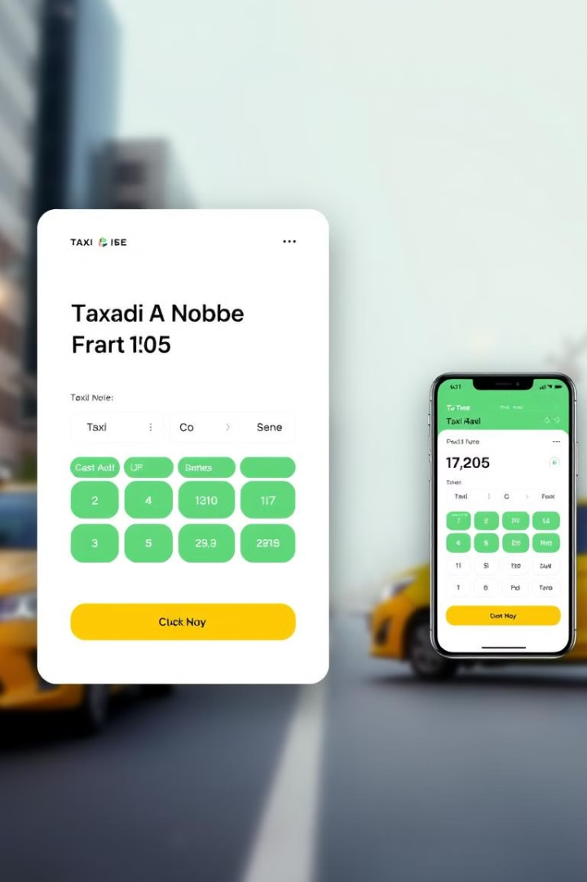
Designing the User Interface
Simplicity
Interactivity
Provide a clean, easy-to-use interface that guides users through the fare estimation process.
Allow users to input details like pick-up and drop-off locations, and see the fare update in real-time.
Responsiveness
Accessibility
Ensure the interface works seamlessly across desktop and mobile devices.
Prioritize accessibility features to accommodate users with diverse needs.

Slide 6
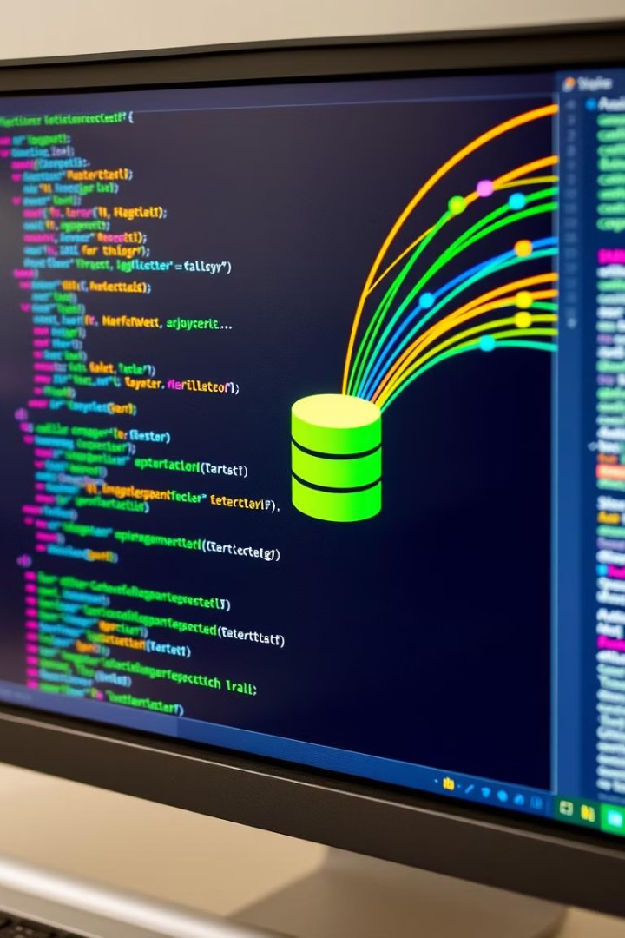



Retrieving Fare Data from the Database
Database Connection
Establish a secure connection to the SQL database storing the fare-related data.
SQL Queries
Utilize SQL queries to retrieve the necessary information, such as base fares and zone-specific rates.
Java Integration
Seamlessly integrate the retrieved data into the Java-based fare calculation logic.

Slide 7




Calculating the Fare Based on Distance and Time
Distance
Retrieve the distance traveled from the vehicle's odometer or GPS data.
Time
Factor in the time elapsed, as some fares may increase during peak hours.
Calculation
Apply the appropriate fare rates and formulas to determine the total cost.

Slide 8
Handling Special Scenarios
Tolls
Surcharges
Discounts
Add any applicable toll charges to the total fare, based on the taxi's route and toll rates.
Consider additional fees, such as airport pick-up or late-night surcharges, and incorporate them into the final calculation.
Implement any relevant discounts, such as for senior citizens or those with disabilities, to ensure fair and equitable pricing.

Slide 9
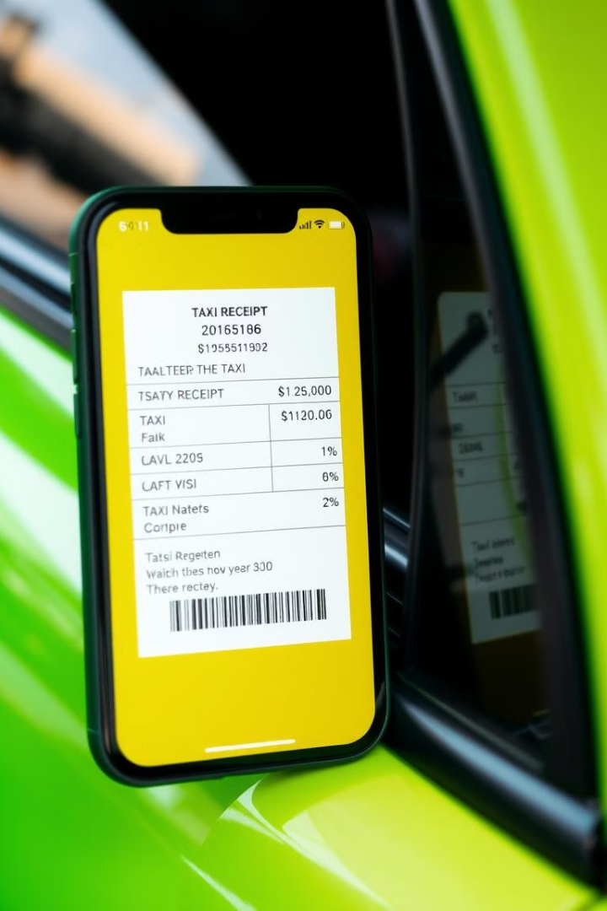
Displaying the Final Fare and Receipt
Clear Breakdown
Receipt Generation
Provide a detailed breakdown of the fare, including all applicable charges and fees, for full transparency.
Generate a digital receipt that the passenger can view, save, or print for their records.
Payment Options
Feedback Mechanism
Offer multiple payment methods, such as cash, card, or mobile payment, to cater to diverse passenger preferences.
Include a feedback mechanism for passengers to report any issues or concerns with the fare calculation.

Slide 10

Conclusion: Benefits of the Taxi Fare Web Page
1
Transparency
2
Efficiency
The Taxi Fare Calculator provides passengers with a clear understanding of the costs involved, promoting trust and satisfaction.
By simplifying the fare estimation process, the web page helps passengers plan their trips and budget more effectively.
3
Seamless Experience
The intuitive interface and real-time calculations deliver a smooth and hassle-free taxi booking experience.

